Slide 1
Secure Data Hiding In Images Using Steganography
CAPSTONE PROJECT
Presented By: Yash G Jadhav
Student Name : Yash G Jadhav
College Name & Department : Mulund College Of Commerce,
BSc Computer Science

Slide 2
OUTLINE
Problem Statement
Technology used
Wow factor
End users
Result
Conclusion
Git-hub Link
Future scope

Slide 3
Problem Statement
In the digital age, protecting data confidentiality is a major challenge. Sensitive information needs a secure method for safe transmission and storage.
Traditional transmission methods are vulnerable to interception, risking privacy and security.
A secure communication technique is needed to hide data without raising any suspicion.
Steganography offers a solution by concealing sensitive information within digital images, making the presence of the message undetectable to unauthorized users.
This project aims to use image steganography to securely hide data within images.

Slide 4
Technology used
Programming Language: Python
Libraries: OpenCV (cv2) – Used for image manipulation and processing.
NumPy – Efficient handling of pixel data in arrays.
Platform: Windows – Compatible with most users.
VS Code – Provides an efficient development environment.
Additional Technology : UTF-8 Encoding- Converts the message into bytes so it can be hidden inside the image.

Slide 5
Wow factors
Secure data transmission: Encrypts and conceals data within images for safe communication.
Minimal Image Distortion: Image quality remains almost unchanged after embedding data.
User friendly: Simple interface for easy encoding and decoding.
Support multiple formats: Works with various image file types like PNG, JPG, BMP.
Real-time steganography: Instantly encodes and decodes messages within images for quick and efficient data hiding.

Slide 6
End users
Cybersecurity Professionals & Enthusiasts: Use it for experiment, research, security analysis and secure communication.
Government & Intelligence Agencies : Protect and securely transmit classified data without raising suspicion.
Journalists, Activists & Whistleblowers : Securely share confidential information without detection.
Corporate Companies & Organizations : Protect confidential business data from attackers and competitors
Individuals & General Users : Safeguard personal data, passwords, and confidential files.

Slide 7
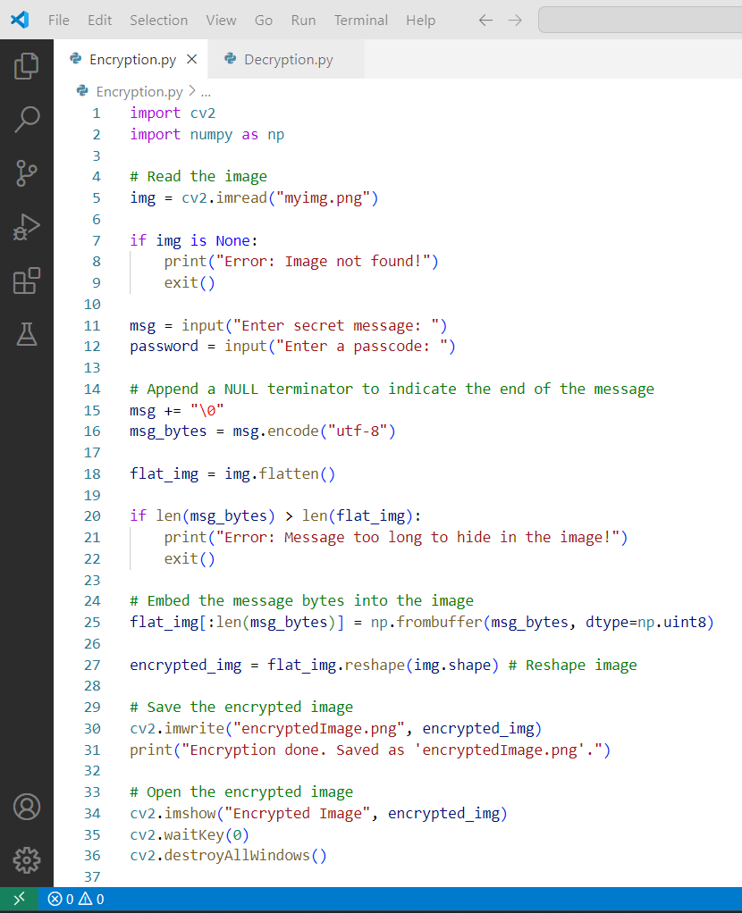
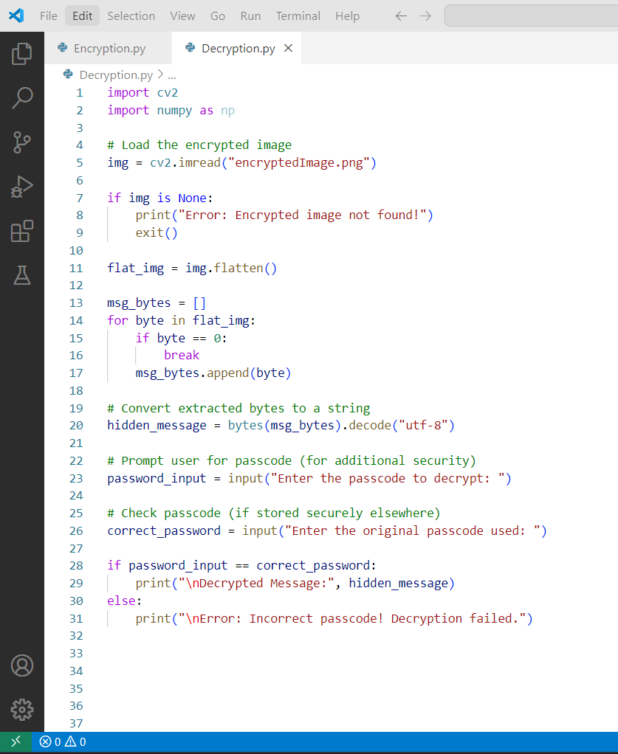
Results
Encryption Code:
Decryption Code:

Slide 8


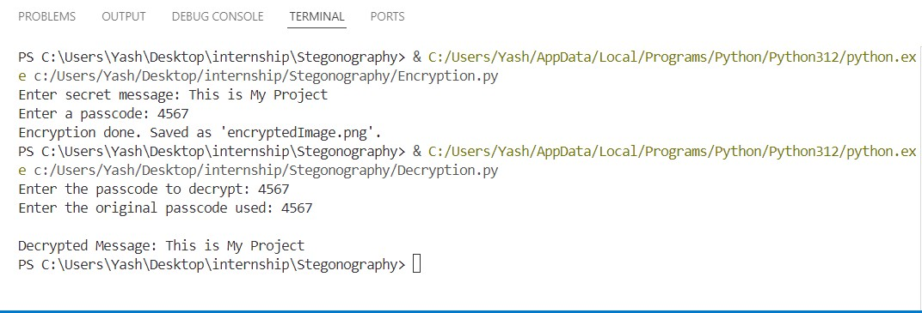
Results
Image before encryption:
Image after encryption:
Encryption and decryption output:

Slide 9
Conclusion
This project successfully demonstrates how steganography can be used to hide and retrieve secret messages within digital images securely
By embedding message bytes into pixel values, sensitive information remains concealed without noticeable visual alterations.
Additionally, the implementation of a passcode verification mechanism adds an extra layer of security, ensuring that only authorized individuals can access the hidden data.
This approach provides a simple yet effective way to communicate confidential data securely, making it useful for privacy-focused applications.
This technique can be further enhanced with stronger encryption methods and improved security measures for practical applications in cybersecurity and secure communication.

Slide 10
GitHub Link
https://github.com/hellolightning/Steganography.git

Slide 11
Future scope(optional)
Advanced Encryption Techniques : Enhancing security by integrating AES, DES or hybrid cryptographic methods for stronger security.
GUI Development : Building an intuitive, user-friendly graphical interface for non-technical users.
Integration with Other Media : Expanding steganography applications to audio, video, and document files.
Mobile & Web Application Development : Making the tool accessible across different devices and platforms.
AI-Powered Steganography & Detection Prevention : Using machine learning to enhance security and resist steganalysis attacks.

Slide 12
THANK YOU

